Slide 1
Curriculum and Instruction
Public Input Budget Presentation

Slide 2
Agenda
Operational & Instructional Materials--J. Hufman
Federal Programs & Grants--B. DeHerrera-Presley
Data and Assessment--L. Venturina

Slide 3
Operational
2020-2021 Budget and Expenditures Overview
Operational Fund Total Budget:
$428, 827
Instructional Materials Fund Budget:
$150,000

Slide 4
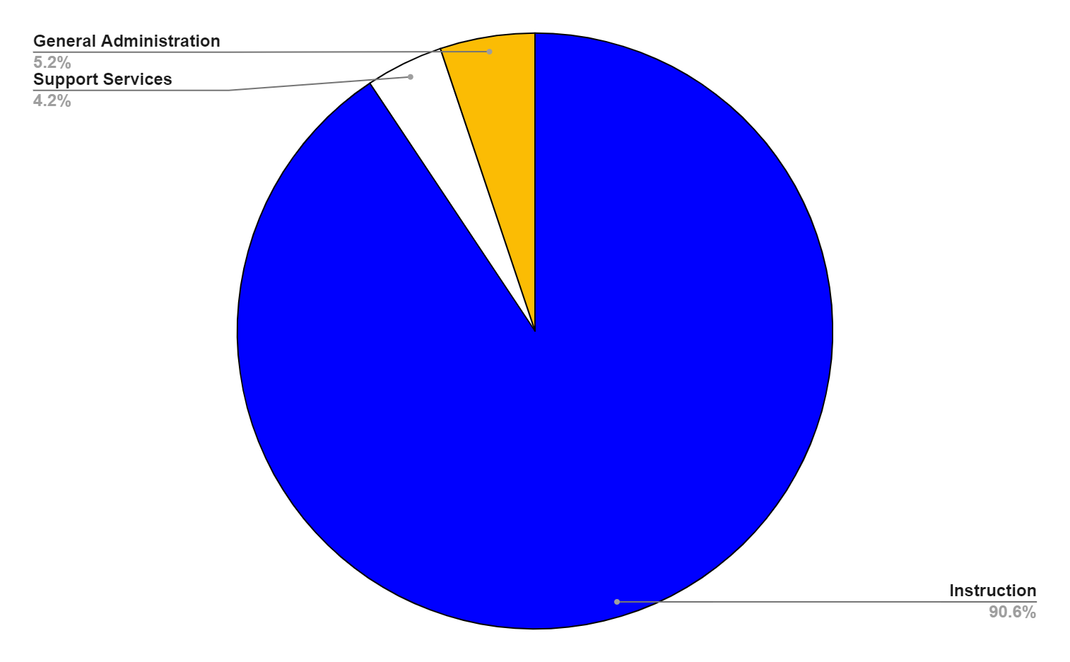
Operational Budget Breakdown

Slide 5
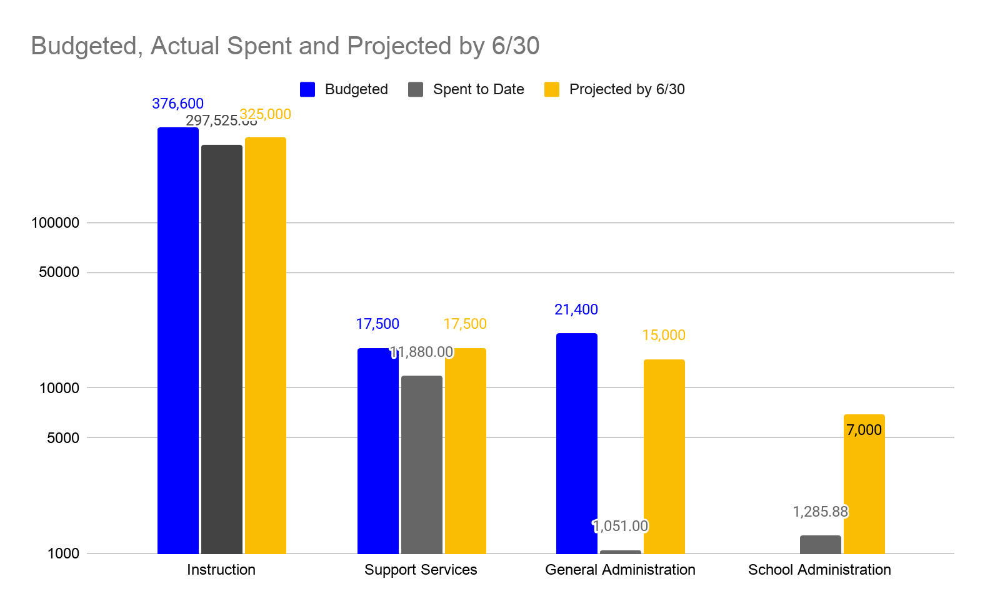
Operational Budget vs. Actuals
Notes:
Why are some categories so underspent? These categories included items like travel for both students and staff, supplies for offices and schools, additional supports for instruction. With the Covid Shutdown for a majority of year, many of these budgets were not spent. However, schools are making special requests for funds to support purchases which they were unable to cover in their school budgets.

Slide 6
Operational Planning for 2021-22
Based on the Budget Survey, the C&I Department will be working on the following Goals for 2021-2022
Staff Development:
Critical Friends Coaching Training for Building Leads, to develop and support teacher agency and best instructional practices.
Continued Training in technology applications
Honoring Teacher Expertise and Skill through training and development of curriculum maps that focus on teacher agency and creativity
Student Technology Access and Skills:
Supports for students and parents to learn technology applications
Parent training for devices and programming
Library Books
Building Classroom Libraries for teachers and students to access during the school day and for teachers to use as curriculum materials
Vocational Programs
Supporting curricular software for all Career/Tech Ed Programs District Wide

Slide 7
Federal Programs
Title I -
Title II
Title IV

Slide 8
Title I — Improving The Academic Achievement Of The Disadvantaged
2019-2020 Carryover $954,700.00
2020-2021 Award $2,419,318.10
Purpose- to ensure all children have a fair equal and significant opportunity to obtain high-quality education with focus on; Disadvantaged, Low-income, Native American, Special Education students, English Language Learners.
Usage of funds include:
85% of total funds at the school level,
Instructional support, supplementary materials,
Supplies for more hands on teaching resources,
After School Tutoring opportunities,
Technology/software for students; ELA and Math interactive programs,
(3)Academic Coaches and (5) Instructional Resource Specialists (Layer 2 Interventions),
Homeless and Negligent student resources,
Family/Parent night resources,
Summer School staff salaries in support of closing student gaps.
Graduating students - Credit Recovery
Notes:
The purpose of this title is to ensure that all children have a fair, equal, and significant opportunity to obtain a high-quality education and reach, at a minimum, proficiency on challenging State academic achievement standards and state academic assessments.

Slide 9
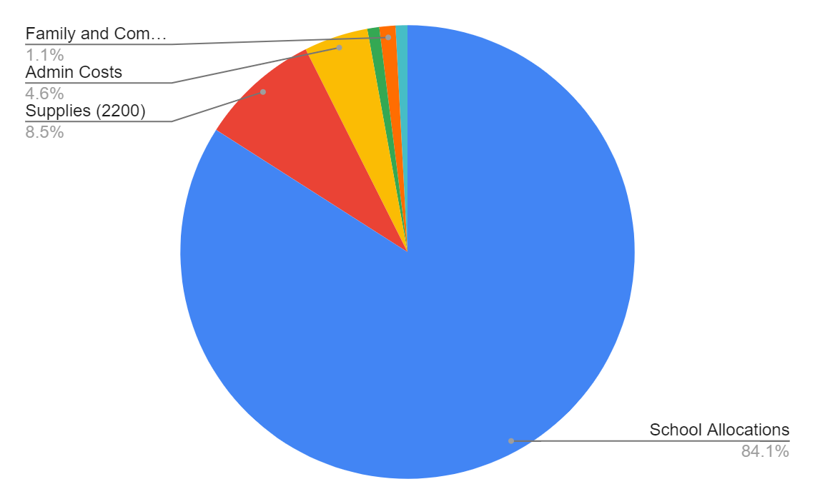
Title I cont.’d
Next Steps:
Critical Friends PD for teacher/building leadership capacity
Continued support of teacher mentors and new teachers
Continued support of Principal PAL’s Leadership
Academic Coaches
Targeted PD in alignment with MLSS model

Slide 10
Title II — Preparing, Training, and Recruiting High Quality Teachers and Principals
2019-2020 Carryover $397,135.00
2020-2021 Award $523,743.00
The purpose is to (1) increase student academic achievement through strategies such as improving teacher and principal quality and increasing the number of highly qualified teachers in the classroom and highly qualified principals and assistant principals in schools; and (2) hold local educational agencies and schools accountable for improvements in student academic achievement.
Usage of funds include:
2 Academic Coaches
Stipends for teachers, building leadership capacity at the building level
Stipends for teacher mentors
Professional development for teachers and principals in technology, applications and using technology platforms
TESOL and college course opportunities for teachers

Slide 11
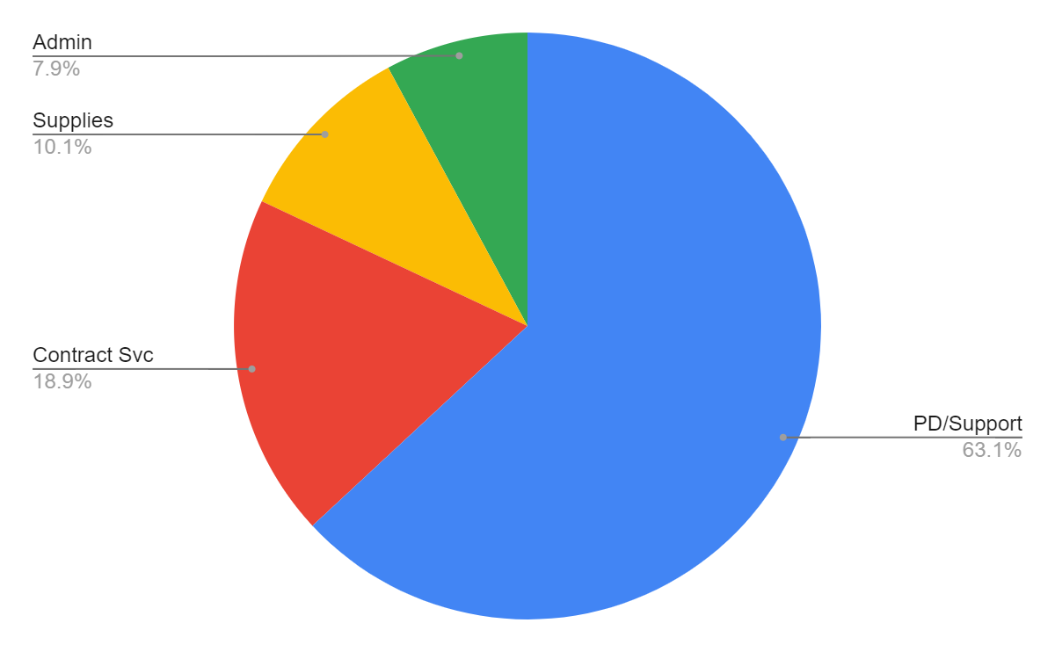
Title II- cont.’d
Next Steps:
Critical Friends PD for teacher/building leadership
Continued support of teacher mentors and new teachers
Continued support of Principal PAL’s
Academic Coaches
Targeted PD in alignment with MLSS model

Slide 12
Title IV - Student Support and Academic Enrichment
2019-2020 Carryover $187,350.00
2020-2021 Award $416,141.00
The purpose of Title IV Part A, Subpart 1 authorizes the expense of federal funds to support students and schools in three domains:
Well-rounded education
Safe and healthy students
Effective use of technology
Usage of funds include:
1 Gifted and Talented Education Coach
Support for school climate improvement ( PAX and PBIS behavioral engagement strategies)
Supplies and Materials for Gifted, Art and Music programs
Resources for performing arts complex(s)

Slide 13
Title IV -cont’d.
Next Steps:
Continued support of Arts, Music and Library
PAC and BiPAC resources
Social and Emotional PD
Climate and Culture PD
Continued support of GATE Coach; supports gifted, music, art and library teachers.
PBIS - behavioral supports and instructional interventions w/ engagement.

Slide 14
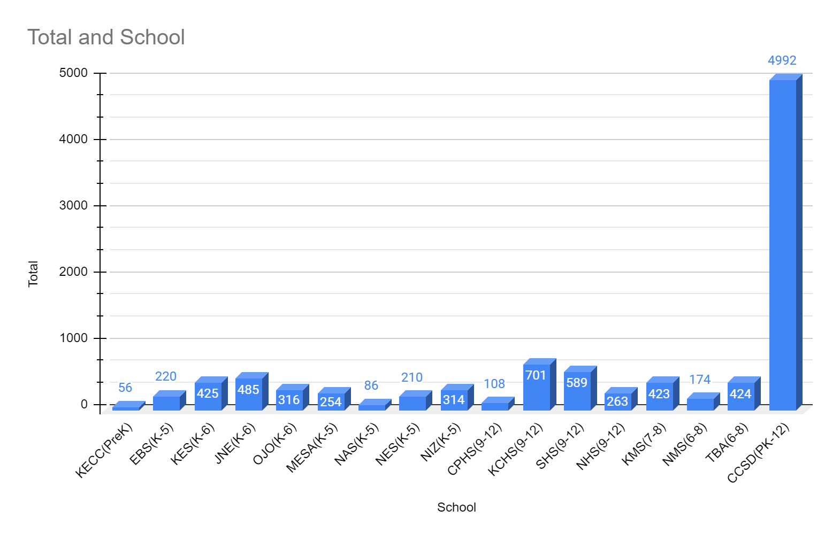
Data and Assessment- Current Enrollment
School | Total
KECC(PreK) | 56
EBS(K-5) | 220
KES(K-6) | 425
JNE(K-6) | 485
OJO(K-6) | 316
MESA(K-5) | 254
NAS(K-5) | 86
NES(K-5) | 210
NIZ(K-5) | 314
CPHS(9-12) | 108
KCHS(9-12) | 701
SHS(9-12) | 589
NHS(9-12) | 263
KMS(7-8) | 423
NMS(6-8) | 174
TBA(6-8) | 424
CCSD(PK-12) | 4992

Slide 15
Data and Assessment

Slide 16
Data and Assessment
New Mexico’s Spring 2021 Available ESSA Assessments
Only Those With Significant Cognitive Disabilities
General Education, Including Disabilities
General Education, Including Disabilities
ELs in General Education, Including Disabilities
Dynamic Learning Maps (DLM)
Measures of Student Success & Achievement (MSSA)
SAT School Day with ESSAY
ACCESS for ELLs
Math 3-8, & 11
Math 3-8
Math 11
ELP K-12
ELA 3-8, & 11
ELA 3-8
Reading 11
ELP = English Language Proficiency
Science 5, 8, & 11
Essay
Assessment of Science Readiness (ASR)
Alternate ACCESS for ELLs
Science 5, 8, 11
ELP 1-12

Slide 17
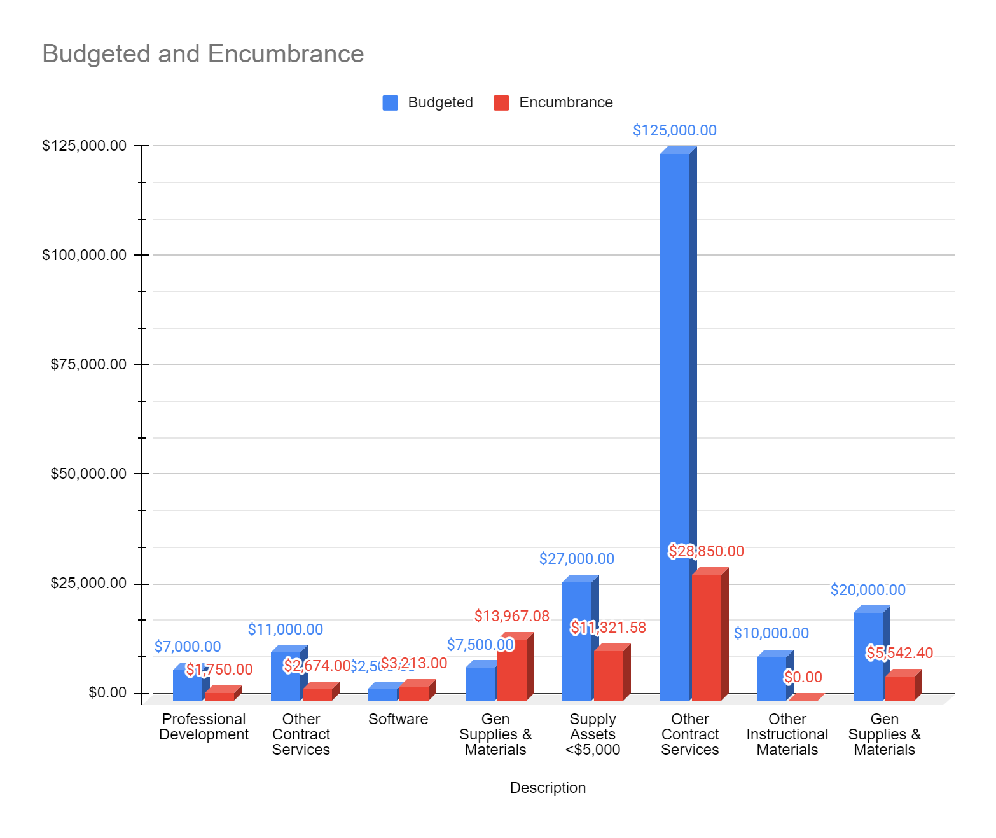
Data and Assessment- Budget
Source | Description | Budgeted | Encumbrance
2200- Support Services_Instructions | Professional Development | $7,000.00 | $1,750.00
2200- Support Services_Instructions | Other Contract Services | $11,000.00 | $2,674.00
2200- Support Services_Instructions | Software | $2,500.00 | $3,213.00
2200- Support Services_Instructions | Gen Supplies & Materials | $7,500.00 | $13,967.08
2200- Support Services_Instructions | Supply Assets <$5,000 | $27,000.00 | $11,321.58
1000- Instructions | Other Contract Services | $125,000.00 | $28,850.00
1000- Instructions | Other Instructional Materials | $10,000.00 | $0.00
1000- Instructions | Gen Supplies & Materials | $20,000.00 | $5,542.40
 | Total | $210,000.00 | $67,318.06

Slide 18
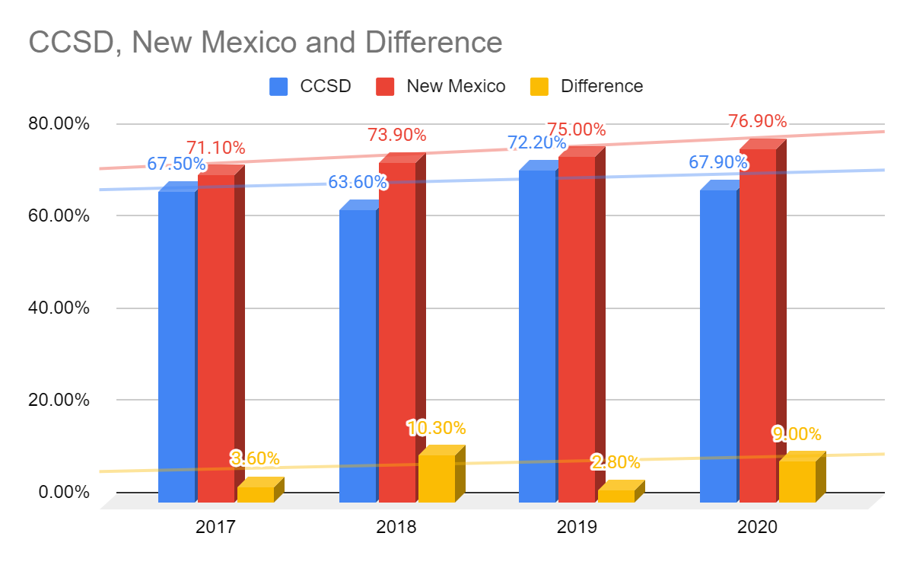
Graduation Data For 4- Year Cohort
 | 2017 | 2018 | 2019 | 2020
CCSD | 67.50% | 63.60% | 72.20% | 67.90%
New Mexico | 71.10% | 73.90% | 75.00% | 76.90%
Difference | 3.60% | 10.30% | 2.80% | 9.00%

